Slide 1
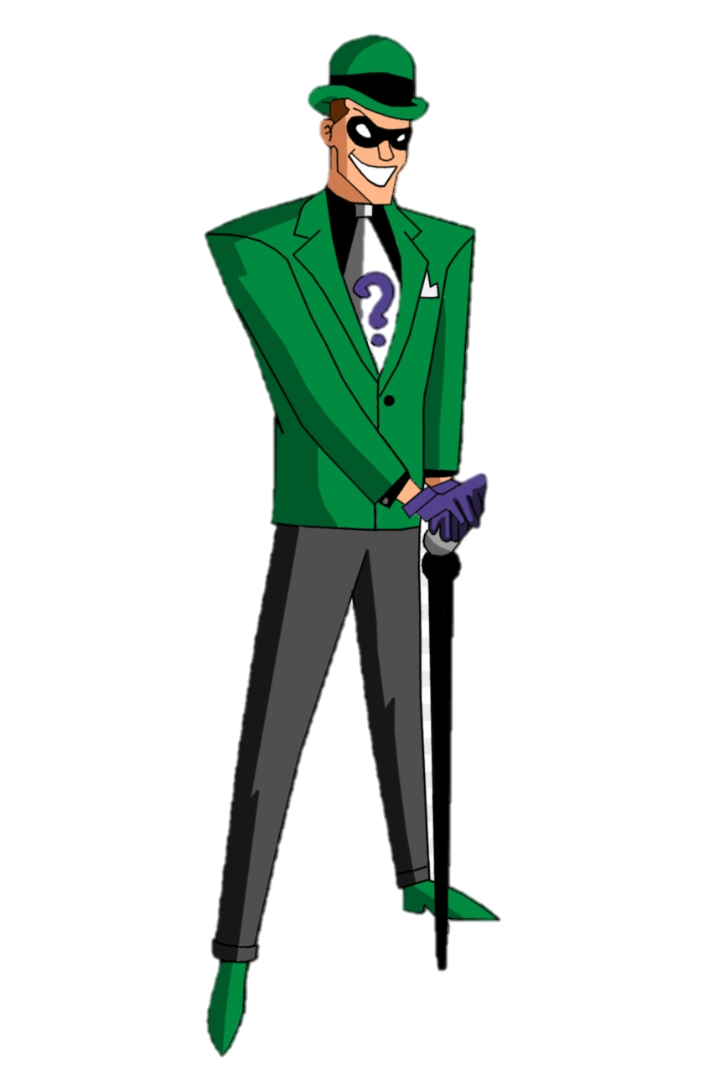
I'm Edward Nigma known as the riddler If you would like to join my clan to defeat Batman you have to collect 70 points, Each stop worth 10 points and if you are stuck just type "hint" and I'll be right for your assistance, Most of my riddles are inspired from this website : www,riddles,com
CoAn = 10p
Hint = 7p
WrAn = 0p
Input = Hint
Bonus
Q9
Q8
CoAn = 10p
Hint = 7p
WrAn = 0p
CoAn = 10p
Hint = 7p
WrAn = 0p
Input = Hint
STAGE 2
Points>70
Congrats
Input = Hint
Input = Hint
Input = Hint
Q5
Q6
Q7
Points < 70
Restart
CoAn = 10p
Hint = 7p
WrAn = 0p
CoAn = 10p
Hint = 7p
WrAn = 0p
Input = Hint
Q1
Q2
CoAn = 10p
Hint = 7p
WrAn = 0p
Points > 37
Input = Hint
STAGE 1
CoAn = 10p
Hint = 7p
WrAn = 0p
Chance = 0
Game Over
CoAn = 10p
Hint = 7p
WrAn = 0p
Q4
Q3
Points < 37
Chance > 0
Input = Hint

